Slide 1
SEC285 Final Project
Michael Miller
College of Engineering and Information Sciences, DeVry University
SEC285 Fundamentals of Information Security
Professor Rami Salahieh
April 23, 2023

Slide 2
Introduction
Information system security is arguably the most important aspect of any computer system or network. Without the tools and advances in InfoSec technology that we use today, the internet would unusable. The following is a summary of labs and lessons learned in DeVry University’s Fundamentals of Information Systems Security class.
Topics Covered
Asymmetric Key Encryption
Stateful Firewalls
Security Policy
Multifactor Authentication (MFA)
Vulnerability Assessment

Slide 3
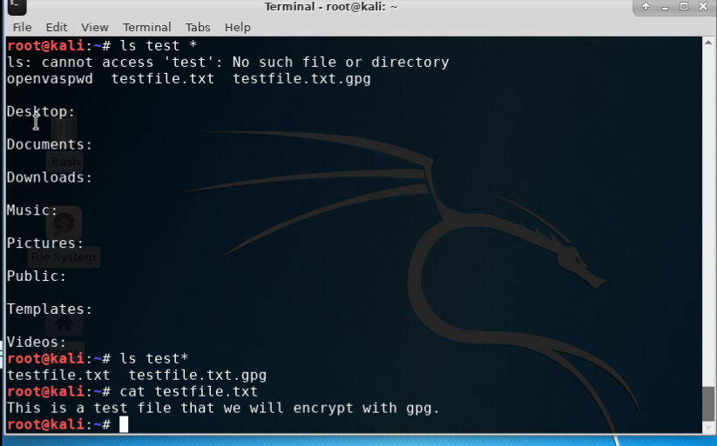
Asymmetric Key Encryption
File Decryption
This screenshot shows the following.
The encrypted file being listed by itself
The decrypting process
Both the encrypted file and the original plaintext file being listed

Slide 4
Asymmetric Key Encryption
File Decryption
This screenshot shows the following.
The encrypted file being listed by itself
The decrypting process
Both the encrypted file and the original plaintext file being listed

Slide 5
Stateful Firewalls
Question
What effect does the sudo iptables --policy INPUT DROP command have on the access to computing resources?
It will drop all incoming traffic

Slide 6
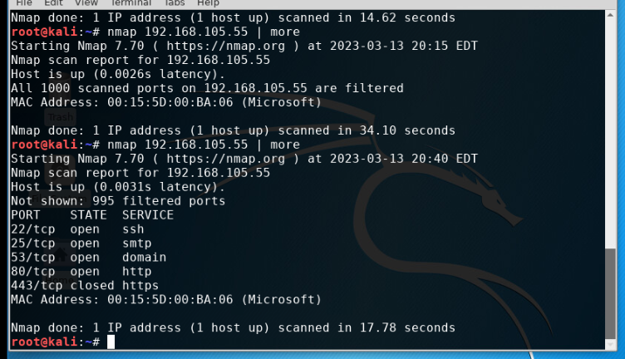
Stateful Firewalls
Nmap Scan
This screenshot shows the Nmap scan result of the Linux Server VM.

Slide 7
Security Policy
Bring Your Own Device (BYOD) Sample policy
1. Overview:
The use of handheld devices is increasing in corporate environments, providing mobile services and constant connectivity to mobile workers. Since handheld devices are recent and not yet properly managed, they present new threats to corporate assets. Handheld devices combine security challenges posed by laptops, removable storage (e.g. USB keys), and cameras.
2. Purpose:
This introduction of BYOD devices introduces new and possibly unknown vulnerabilities to a corporate network. The timely discovery of these vulnerabilities is vital to network and information security. When found and dealt with immediately the effects of an attack can be minimized or even eliminated.
All users must understand that whenever a computer device is connected to the organization’s network, systems, or computers, opportunities exist for:
Introducing viruses, spyware, or other malware.
Purposefully or inadvertently copying sensitive and/or proprietary organization information to unauthorized devices.
Introducing a technical or network incompatibility to the organization that the user is not even aware of.
Loss of data that may adversely affect the organization if it falls into the wrong hands.

Slide 8
Security Policy
Bring Your Own Device (BYOD) Sample policy
3. Scope:
This policy applies to all employees, consultants, vendors, contractors, students, and others using business or private mobile handheld devices on any premises occupied by ABC Corporation. At no time is a personal or non-company issued device allowed to connect (wired or wireless) to the intranet or any network managed by ABC Corporation. Only company issued mobile devices are allowed to access the network, and users must abide by all policies applying to those devices listed below. All mobile devices used to connect to the network must be approved and issued by the IT management team before such use.
4. Policy:
IT Department Responsibilities
Monitoring the company network for unauthorized access by unapproved devices.
Ensuring that all company issued mobile devices are properly configured and have the necessary anti-malware installed
Maintaining a log of all company issued devices, their current status, and location or person issued to.
Performing quarterly spot checks on devices issued to employees to ensure configurations and security software has not been tampered with.
User Responsibilities
Ensuring any personal mobile/computer device is not connected to the company network.
Ensuring that company issued devices are not employed for personal use.
If company issued devices are malfunctioning or performing poorly the device should be immediately turned off and brought to IT for repair/replacement.

Slide 9
Security Policy
Bring Your Own Device (BYOD) Sample policy
5. Policy Compliance:
Failure to comply with the above stated policy will be subject to disciplinary actions up to and including termination of employment.
Scenarios that could result in disciplinary action or termination include but are not limited to:
Accessing the company network with an unapproved device.
Jailbreaking/rooting of a company issued device.
Removing or bypassing the security software of a company issued device.
Modifying the configuration of a company issued device.
Installing unapproved software on a company issued device.
6. Related Standards, Policies, and Processes:
In addition to the above policy, all devices used to access the company network must be in compliance with the following standards:
HIPPA (Health Insurance Portability and Accountability Act of 1996)
Protection of individual identifiable health information
PCI-DSS (Payment Card Industry Data Security Standard)
Ensures the safe and secure transfer of credit card data

Slide 10
Security Policy
Bring Your Own Device (BYOD) Sample policy
7. Definitions and Terms:
BYOD – Bring your Own Device
Mobile device – Any computer device designed to be used for mobile application. Examples are: mobile phone, tablet computer, or laptop/notebook computer.
CIA – Confidentiality, Integrity, and Availability. The three fundamental principles of information security.
Vulnerability – An inherent weakness in a device’s software or hardware security protection.
Viruses, spyware, or malware – Any software, digital file, or installable code created with the intent to do harm to the infected computer or network.
Jailbreaking/rooting – The process of removing limitations on a mobile phone or tablet to allow access to the “root” file system of the device.
8. Revision History:
Date of change | Responsible | Summary of change
August 2019 | SANS policy team | Updated and converted to new format
March 26, 2023 | Michael J. Miller | Updated

Slide 11
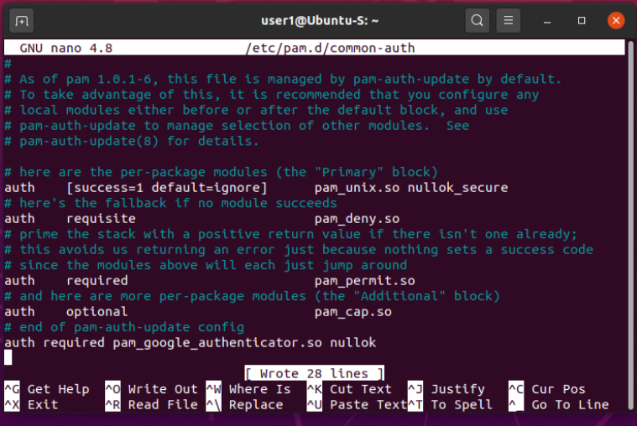
Multifactor Authentication (MFA)
Common-auth Configuration File
This screenshot shows the entry that indicates the use of the Google Authenticator module.

Slide 12
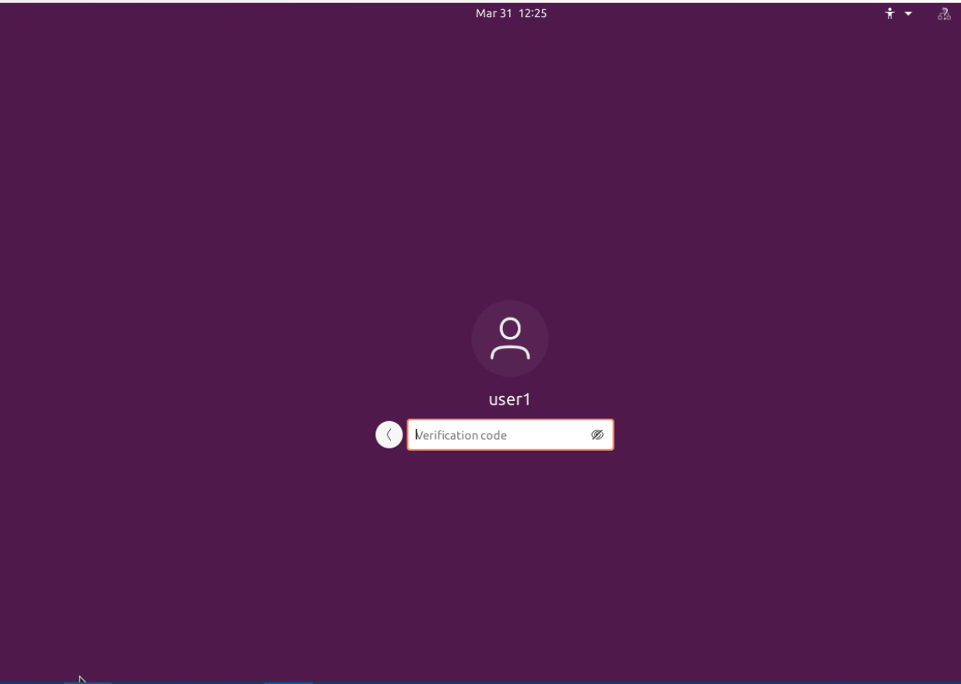
Multifactor Authentication (MFA)
MFA Logon Screen
This screenshot shows the logon screen where a verification code is required.

Slide 13
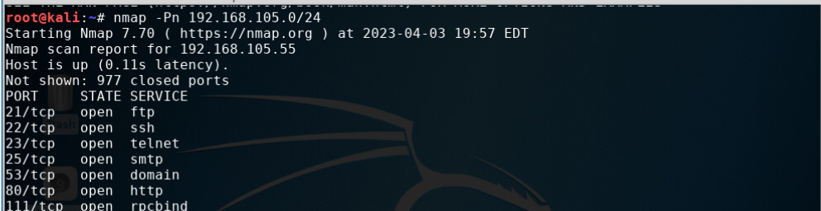
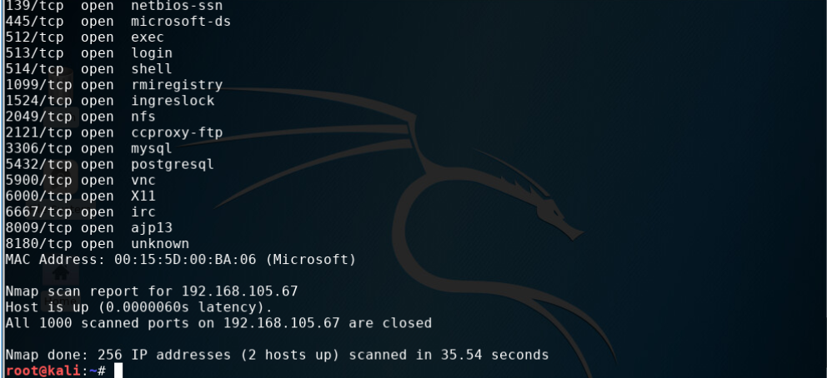
Vulnerability Assessment
NMAP
This screenshot includes the scan result showing both the Kali and Linux Server VMs.

Slide 14
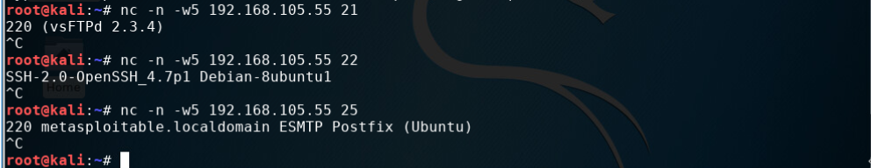
Vulnerability Assessment
NetCat
This screenshot includes the scan result showing both the Kali and Linux Server VMs.

Slide 15
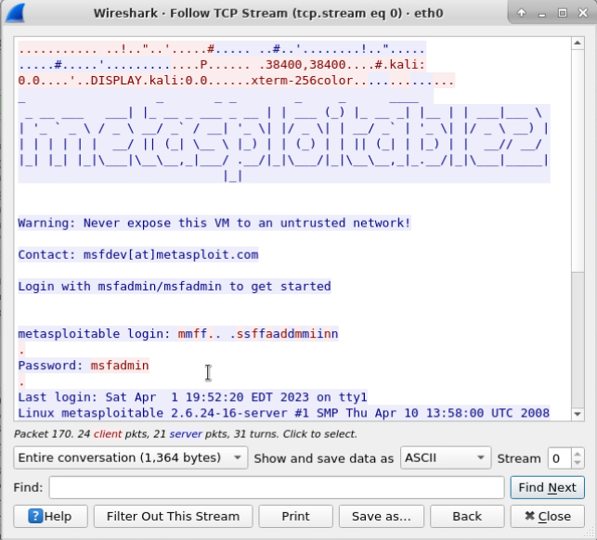
Vulnerability Assessment
Wireshark
This screenshot includes the Wireshark—Follow TCP Steam window showing the Telnet username and password.

Slide 16
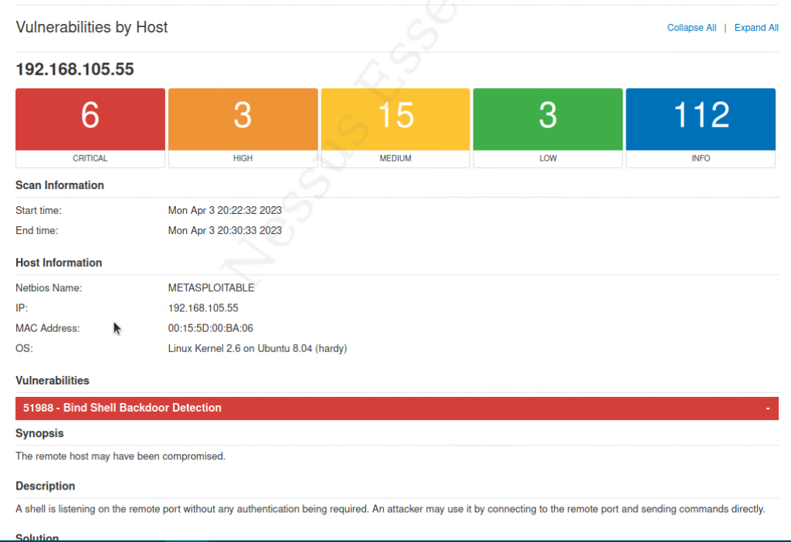
Vulnerability Assessment
nessus
This screenshot includes the high-level view of the Nessus vulnerability scan report (showing categories of vulnerability in different colors).

Slide 17
Challenges
Learning Kali Linux
Understanding and writing a security policy
Learning numerous securitytools
Nmap
NetCat
Wireshark
Nessus

Slide 18
Career Skills
Linux command line
Virtualization
InfoSec policy
Cryptography
Wireless network and device security
Risk management
Identity and access management
Network attacks and defenses

Slide 19
Conclusion
Information system security is arguably the most important aspect of any computer system or network. Without the tools and advances in InfoSec technology that we use today, the internet would unusable. The following is a summary of labs and lessons learned in DeVry University’s Fundamentals of Information Systems Security class.

